Slide 1
Artificial Intelligence
CS-451
Instructor: Dr Syed Musharaf Ali

Slide 2

Machine Learning

Slide 3


Slide 4
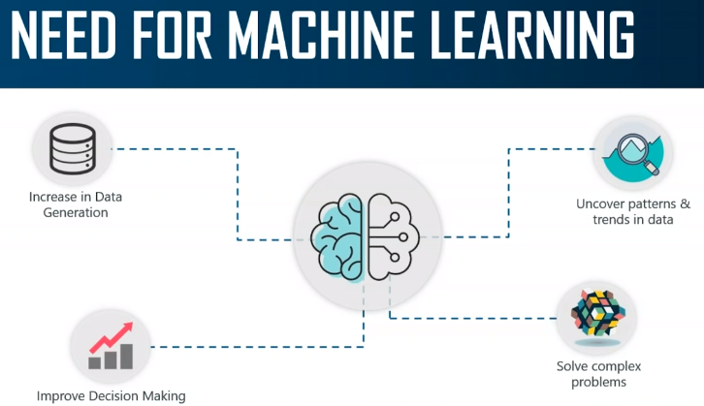

Slide 5
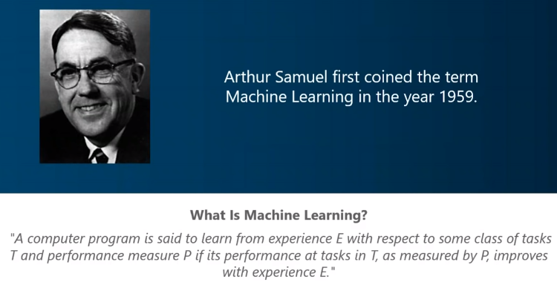

Slide 6
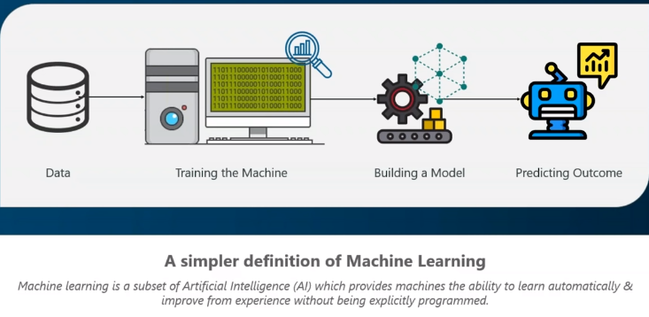

Slide 7
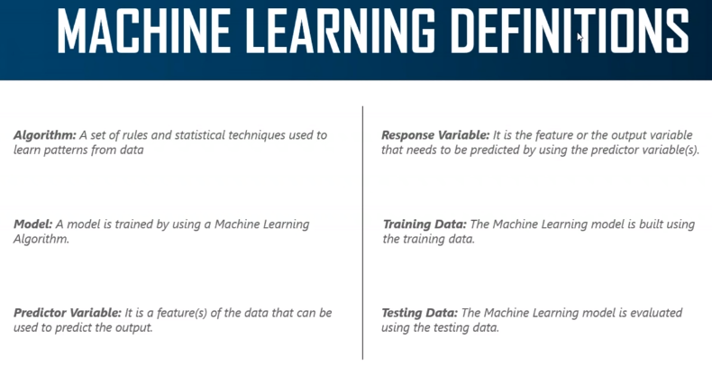

Slide 8
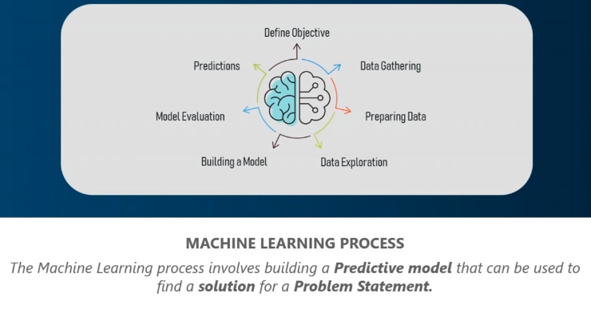

Slide 9
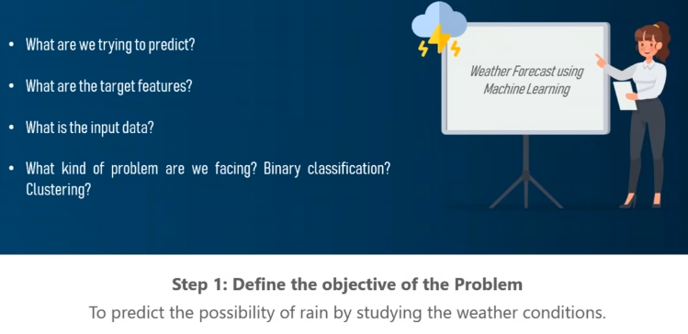

Slide 10
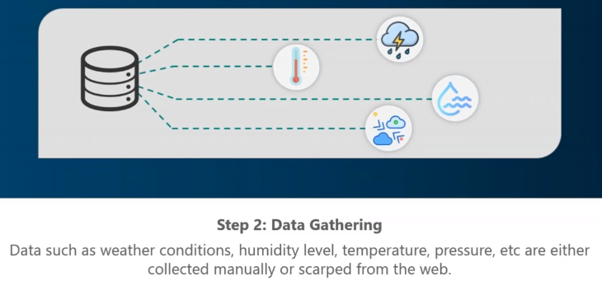

Slide 11
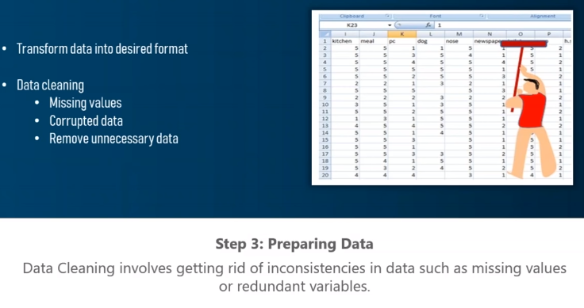

Slide 12
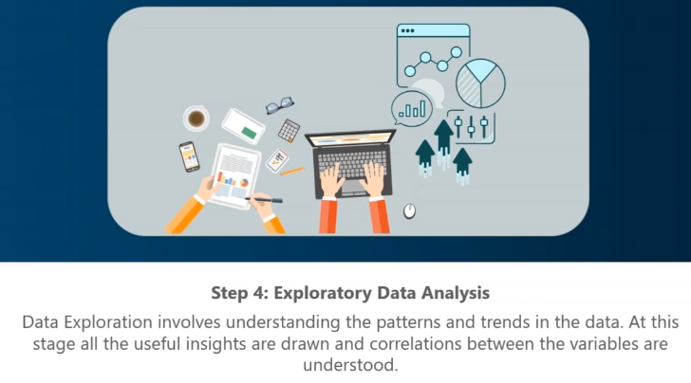

Slide 13
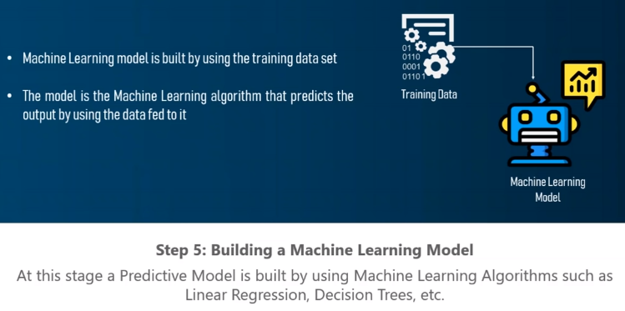

Slide 14
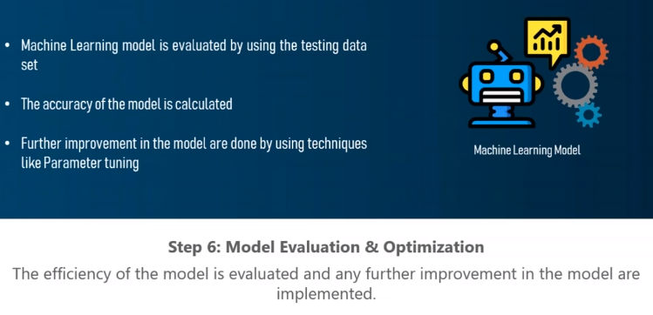

Slide 15
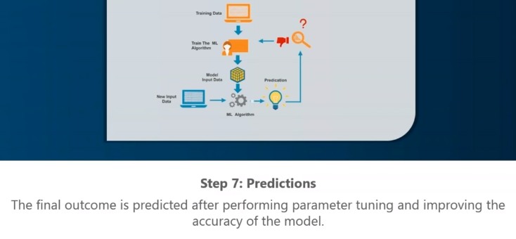

Slide 16
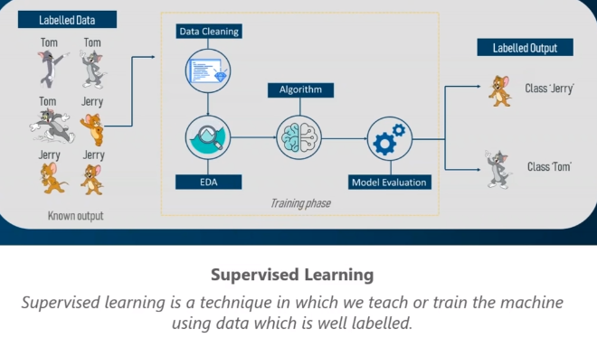

Slide 17
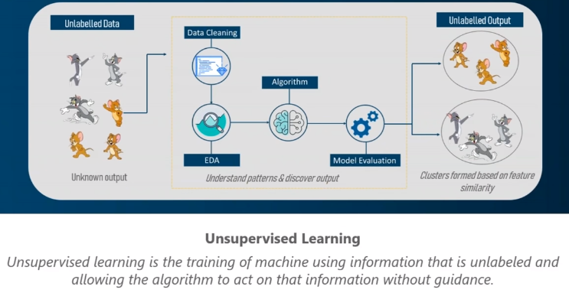

Slide 18
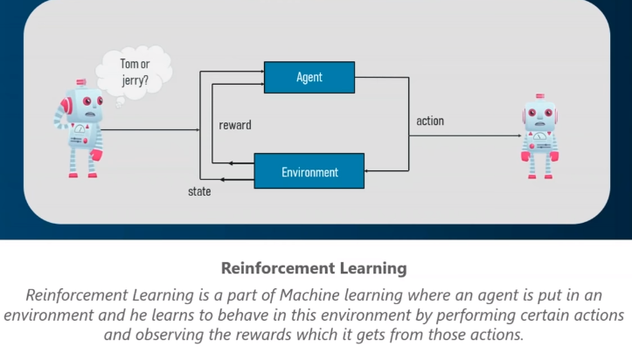

Slide 19
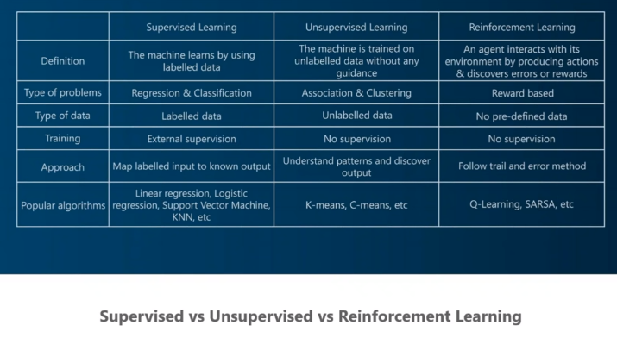

Slide 20
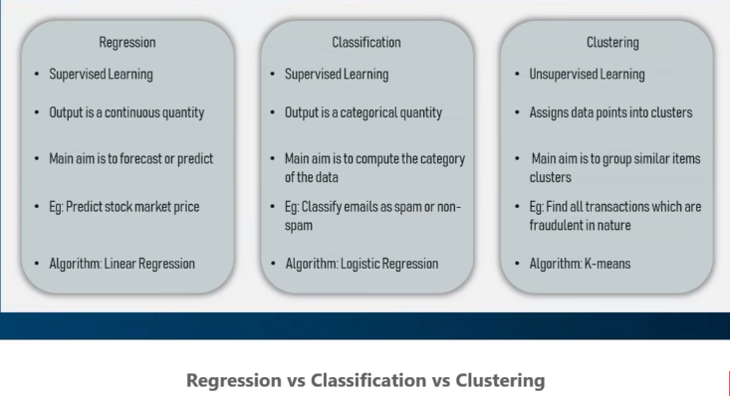
Categorization of machine learning tasks:

Slide 21
Machine Learning
There are three types of Learning:
Supervised learning: The computer is presented with example inputs and their desired outputs, and the goal is to learn a general rule or function that maps inputs to outputs.
Unsupervised learning: No labels are given to the learning algorithm, leaving it on its own to find structure in its input. Discovering hidden patterns in data.
Reinforcement learning: A computer program interacts with a dynamic environment in which it must perform a certain goal (such as driving vehicle or playing a game against an opponent).
The program is provided feedback in terms of rewards and punishments as it navigates its problem space.

Slide 22
Machine Learning
Categorization of machine learning tasks:
Classification: Inputs are divided into two or more classes, and the learner must produce a model that assigns unseen inputs to these classes. This is typically tackled in a supervised way e.g. spam filtering is an example of classification, where the inputs are email (or other) messages and the classes are "spam" and "not spam".
Regression: The outputs are continuous rather than discrete, e.g. temperature, currency rates, stock rates, oil prices etc. Supervised learning
Clustering: a set of inputs is to be divided into groups. Unlike in classification, the groups are not known beforehand, making this typically an unsupervised task.

Slide 23
Machine Learning
Anything you can do with 1 second of thought
We can probably now or soon automate

Slide 24
Machine Learning
Human intention detection

Slide 25
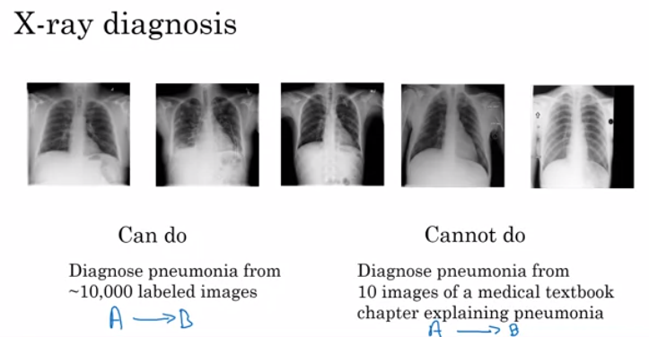
Machine Learning

Slide 26
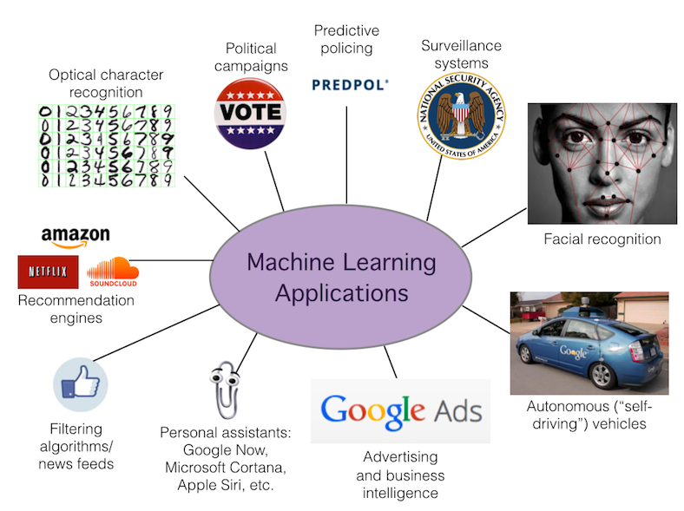

Slide 27
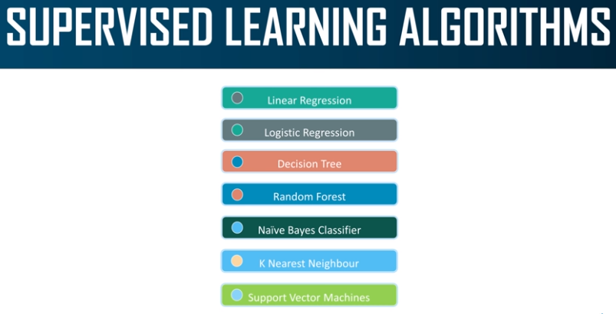

Slide 28
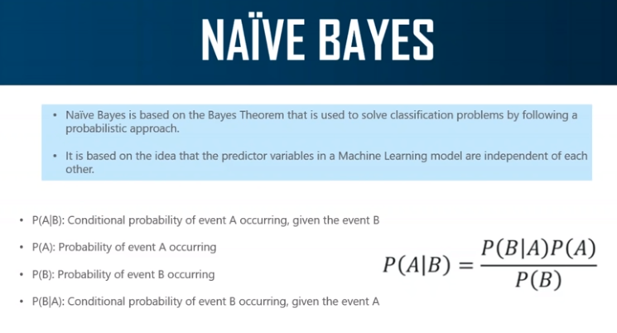

Slide 29
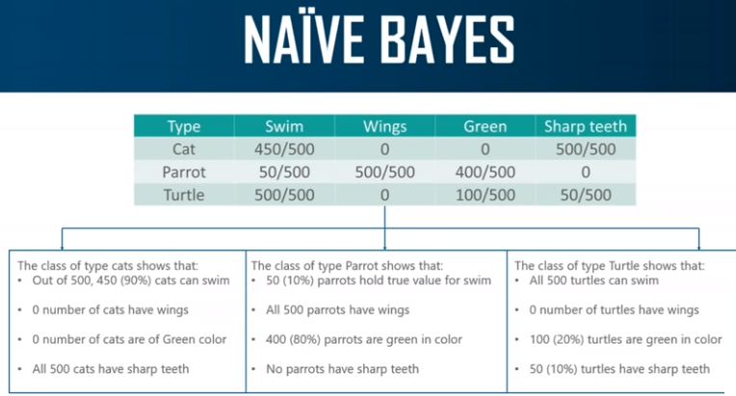

Slide 30
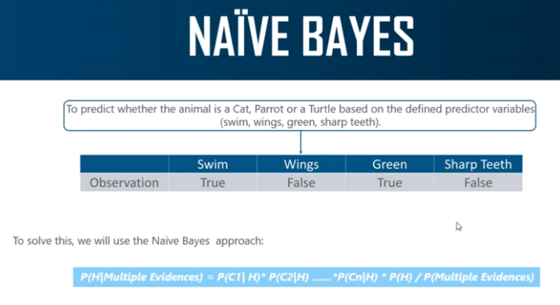

Slide 31
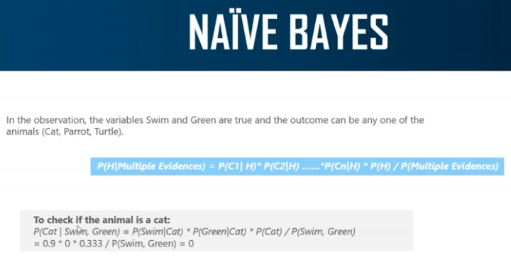

Slide 32
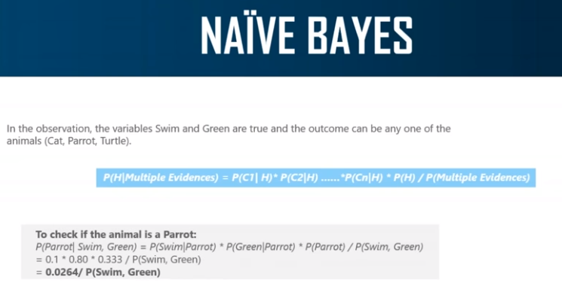

Slide 33
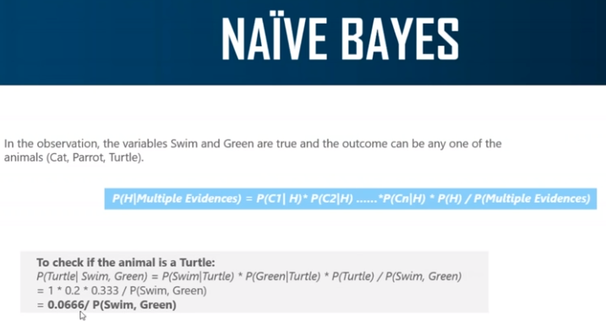

Slide 34
Machine Learning
Example: Supervised Learning based Classification using Naïve Bayes Classifier:
Problem: Classify whether a given person is a male or a female based on the measured features. The features include height, weight, and foot size.

Slide 35
Machine Learning
Example: Supervised Learning based Classification using Naïve Bayes Classifier:
Training Set
Gender | height (feet) | weight (lbs) | foot size(inches)
male | 6 | 180 | 12
male | 5.92 | 190 | 11
male | 5.58 | 170 | 12
male | 5.92 | 165 | 10
female | 5 | 100 | 6
female | 5.5 | 150 | 8
female | 5.42 | 130 | 7
female | 5.75 | 150 | 9
Test Data
Gender | height (feet) | weight (lbs) | foot size(inches)
Sample | 6 | 130 | 8

Slide 36
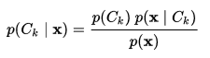
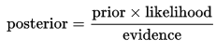
Machine Learning
Example: Supervised Learning based Classification using Naïve Bayes Classifier:
Naïve Bayes Classifier:
In simple words

Slide 37
Machine Learning
Example: Supervised Learning based Classification using Naïve Bayes Classifier:
The classifier created from the training set using a Gaussian distribution assumption
Where σ is variance of each feature set, µ is the mean of each feature set
x is the feature, v is the value of a feature x and c is the class of feature x
σc and µc are the mean variance and mean feature value of the given class c

Slide 38
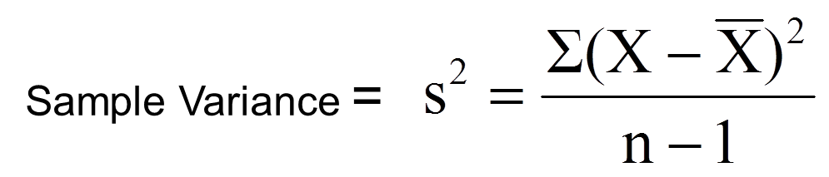
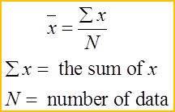
Machine Learning
Example: Supervised Learning based Classification using Naïve Bayes Classifier:
Training:
Gender | mean (height) | variance (height) | mean (weight) | variance (weight) | mean (foot size) | variance (foot size)
Male | 5.855 | 0.0350 | 176.25 | 1.2292e+02 | 11.25 | 9.1667e-01
Female | 5.4175 | 0.0972 | 132.5 | 5.5833e+02 | 7.5 | 1.6667e+00
Mean

Slide 39
Machine Learning
Example: Supervised Learning based Classification using Naïve Bayes Classifier:
Testing: Sample to be classified as a male or female.
Gender | height (feet) | weight (lbs) | foot size(inches)
Sample | 6 | 130 | 8
We assume that we have equi-probable classes so
P(male)= P(female) = 0.5
This prior probability distribution might be based on our knowledge of frequencies in the larger population, or on frequency in the training set

Slide 40

Machine Learning
Example: Supervised Learning based Classification using Naïve Bayes Classifier:
Testing:
We have to determine which posterior is greater, male or female for the given sample

Slide 41
Machine Learning
Example: Supervised Learning based Classification using Naïve Bayes Classifier:
Testing:
We have to determine which posterior is greater, male or female for the given sample

Slide 42
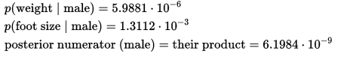
Machine Learning
Example: Supervised Learning based Classification using Naïve Bayes Classifier:
Testing:
Male Posterior

Slide 43
Machine Learning
Example: Supervised Learning based Classification using Naïve Bayes Classifier:
Testing:
Female Posterior

Slide 44
Machine Learning
Example: Supervised Learning based Classification using Naïve Bayes Classifier:
Result:
As we found that Female Posterior is greater than Male posterior so the given sample is of Female
Gender | height (feet) | weight (lbs) | foot size(inches)
Sample | 6 | 130 | 8
Source : https://en.wikipedia.org/wiki/Naive_Bayes_classifier
Example: Gender classification

Slide 45
Machine Learning

Slide 46
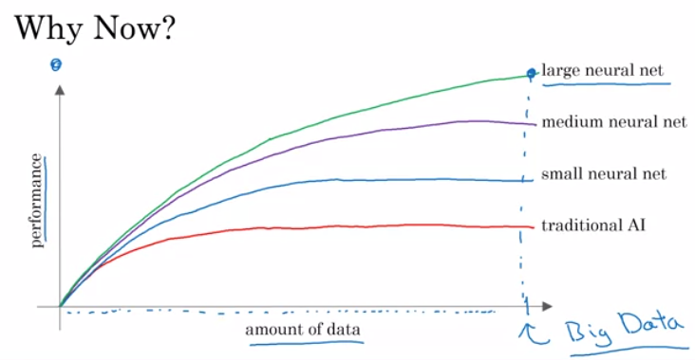
Machine Learning

